Slide 1
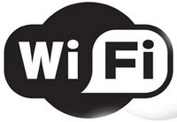
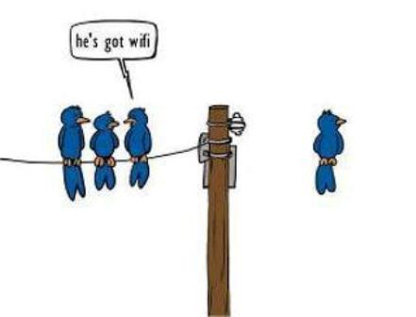


Slide 2

Wireless technology has widely spread and you can get connected almost anywhere; at home, at work, in libraries, schools, airports, hotels and even in some restaurants.
Wireless networking is known as Wi-Fi (Wireless Fidelity) or 802.11 networking as it covers the IEEE 802.11 technologies. The major advantage of Wi-Fi is that it is compatible with almost every operating system, game device and advanced printer.
Wi-Fi is increasingly becoming the preferred mode of internet connection all over the world. To access this type of connection, one must have a wireless adapter on their computer. Wi-Fi provides wireless connectivity by emitting frequencies between 2.4GHz to 5GHz. Areas which are enabled with Wi-Fi connectivity are known as Hot Spots.

Slide 3

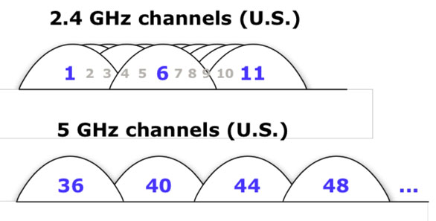
The Gigahertz (GHz) range of a wireless device is not related to the maximum speed of the wireless network. For example, wireless-A runs only on the 5 GHz band and supports a maximum data rate of up to 54 mbps which is the same as wireless-G running on the 2.4 GHz band. Basically both have the same data rate but they’re only running on different bands. The environment in which the network will be setup is what really should be considered.

Slide 4

IEEE 802.11 “denotes a set of Wireless LAN(WLAN) standards developed by working group 11 of the IEEE(Institute Of Electrical & Electronics Engineers) LAN/WAN Standards Committee (IEEE 802)”

Slide 5

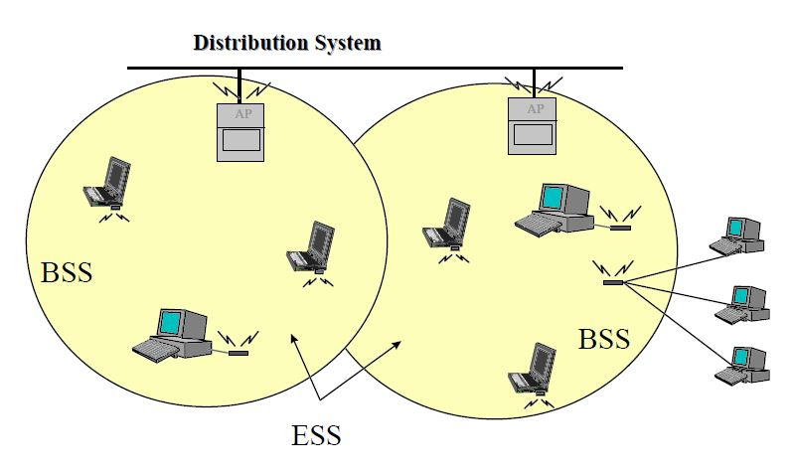
An 802.11 LAN is based on a cellular architecture where the system is subdivided into cells, where each cell (called Basic Service Set or BSS) is controlled by a Base Station (called Access Point).

Slide 6
Even though that a wireless LAN may be formed by single cell, with a single Access Point, most installations will be formed by several cells, where the Access Point are connected through some kind of backbone (called Distribution System or DS), typically Ethernet.

Slide 7
The whole interconnected Wireless LAN including the different Cells, their respective Access Points and the Distribution System, is seen to the upper layers of OSI Model, as a single Network, and is called in the Standard as Extended Service Set (ESS).

Slide 8

When a station wants to access an existing BSS (either after power-up, sleep mode, etc), the cell needs to get synchronization information from Access point. The BSS can get this information by one or two means.
Passive Scanning
Active Scanning

Slide 9
Passive scanning: In this case the cell just waits to receive a Beacon Frame from AP, (the Beacon Frame is a periodic frame sent by AP with synchronization information), or
Active scanning: In this case the cell tries to find an Access point by transmitting Probe Request Frames, and waiting for Probe Response from AP.

Slide 10
The two methods are Valid, and either one can be chosen according to the power consumption, performance, environment, etc.,

Slide 11

Once the cell has found an Access Point, and decided to join , it will go through the Authentication Process, which is the interchange of information between the AP and the station, where each side proves the knowledge of a given password.

Slide 12

When the cell is authenticated, then it will start the Association Process, which is exchange of information about the stations and BSS capabilities, and which allows the DSS (Data Security Standard to prevent unauthorised data sharing). Only after the association process is completed, a station is capable of transmitting and receiving data frames.

Slide 13

Stations need to keep synchronization, this is need for keeping synchronized, and other function like Power Saving. By every BSS this is performed every time by updating their clocks according to the AP's clock, using the following mechanism.
The AP transmits periodic frames called Beacon Frames, these frames contain the value of the AP's clock on the moment of the transmission.
The receiving stations check the value of their clock at the receiving moment, and correct it to keep synchronizing with the AP's clock.

Slide 14

There are three main types of frames:
Data Frames: Which are used for Data transmission.
Control Frames: Which are used to control access to the medium (e.g. RTS, CTS and ACK)
Management Frames: Which are frames that are transmitted the same way as data frames to
exchange management information.
Each of these types is as well subdivided into different subtypes, according to their specific function.

Slide 15

Protocols | Release Date | Op. Frequency | Date Rate (Typ) | Date Rate (Max) | Range (indoor)
Legacy | 1997 | 2.4 – 2.5 GHz | 1 Mbit/s | 2 Mbit/s | ~20 meters (~66 feet)
802.11a | 1999 | 5.15-5.35/5.47-5.725/5.725-5.875 GHz | 25 Mbit/s | 54 Mbit/s | ~30 meters (~100 feet)
802.11b | 1999 | 2.4 – 2.5 GHz | 6.5 Mbit/s | 11 Mbit/s | ~50 meters (~150 feet)
802.11g | 2003 | 2.4 – 2.5 GHz | 11 Mbit/s | 54 Mbit/s | ~30 meters (~100 feet)
802.11n | 2006 | 2.4 GHz or 5GHz bands | 200 Mbit/s | 540 Mbit/s | ~50 meters (~160 feet)

Slide 16

IEEE 802.11 | The original 1 Mbit/s and 2 Mbit/s , 2.4 GHz RF and IR standard (1999)
IEEE 802.11a | 54 Mbit/s, 5 GHz standard (1999, shipping products in 2001)
IEEE 802.11b | Enhancements to 802.11 to support 5.5 and 11 Mbit/s (1999)
IEEE 802.11c | Bridge operation procedures; included in the IEEE 802.1D standard (2001)
IEEE 802.11d | International (country-to-country) roaming extensions (2001)
IEEE 802.11e | Enhancements: QoS, including packet bursting (2005)
IEEE 802.11f | Inter-Access Point Protocol (2003) Withdrawn February 2006
IEEE 802.11g | 54 Mbit/s, 2.4 GHz standard (backwards compatible with b) (2003)
IEEE 802.11h | Spectrum Managed 802.11a (5 GHz) for European compatibility (2004)
IEEE 802.11i | Enhanced security (2004)
IEEE 802.11j | Extensions for Japan (2004)

Slide 17

IEEE 802.11k | Radio resource measurement enhancements
IEEE 802.11l | (reserved and will not be used)
IEEE 802.11m | Maintenance of the standard; odds and ends.
IEEE 802.11n | Higher throughput improvements using MIMO (multiple input, multiple output antennas)
IEEE 802.11o | (reserved and will not be used)
IEEE 802.11p | WAVE - Wireless Access for the Vehicular Environment (such as ambulances and passenger cars)
IEEE 802.11q | (reserved and will not be used, can be confused with 802.1Q VLAN trunking)
IEEE 802.11r | Fast roaming Working "Task Group r"
IEEE 802.11s | ESS Mesh Networking
IEEE 802.11T | Wireless Performance Prediction (WPP) - test methods and metrics Recommendation
IEEE 802.11u | Interworking with non-802 networks (for example, cellular)
IEEE 802.11v | Wireless network management
IEEE 802.11w | Protected Management Frames
IEEE 802.11x | (reserved and will not be used)
IEEE 802.11y | 3650-3700 Operation in the U.S.
IEEE 802.11Z | Extensions to Direct Link Setup (DLS) (September 2010)

Slide 18

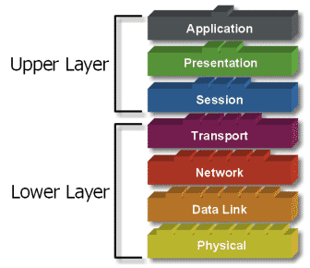
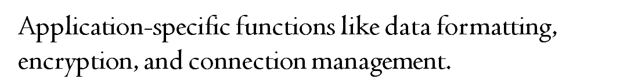
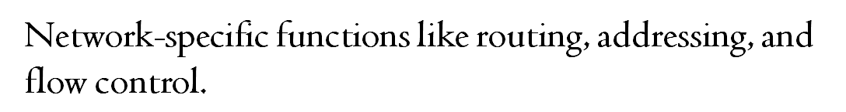

Slide 19

The physical layer in 802.11 is split into Physical Layer Convergence Protocol (PLCP) and the Physical Medium Dependent (PMD) sub layers.
The PLCP prepares data units transmitted/received using various 802.11 media access techniques.
The PMD performs the data transmission/reception and modulation/demodulation directly under the guidance of the PLCP.

Slide 20

The physical layer of the original 802.11 standardized three
wireless data exchange techniques:
Infrared (IR)
Frequency hopping spread spectrum (FHSS)
Direct sequence spread spectrum (DSSS).

Slide 21

Frequency Hopping
The frequency hopping was the first step in the evolution to the DSSS and more complex data transmission techniques. The idea is to transmit on a given frequency for a very short time and switch to another frequency according to a pre-defined frequency hopping pattern known to both transmitter and receiver. This allows to deal with high energy interference in a narrow band as well mutual interference
802.11 frequency hopping separates the whole 2.4Ghz band into channels spaced 1MHz. The transmitter has to change channels at least 2.5 times per second (every 400msec or less).

Slide 22
Frequency Hopping Cont..
The hopping patterns are described by Sets containing hopping sequences each. The sets are defined in such way that the sequences in each set, when set up on different access points, provide minimum mutual interference.
Mostly used in Military & Civilian.
The FHSS is quite stable to interference, cost effective and simple data transmission technique but it is not widely used for WLANs nowadays. Mostly because of its growing requirements to bandwidth when data transmission rates are increased.

Slide 23
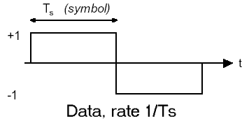
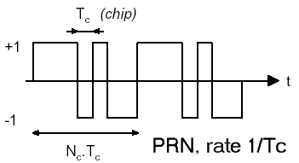
Direct sequence spread spectrum (DSSS).
Direct-sequence spread-spectrum transmissions multiply the data being transmitted by a "noise" signal. This noise signal is a pseudorandom sequence of +1 and −1 values, at a frequency much higher than that of the original signal.
However, this noise-like signal can be used to exactly reconstruct the original data at the receiving end, by multiplying it by the same pseudorandom sequence . This process, known as "de-spreading",

Slide 24

The data link layer is the protocol layer which is used to transfer data between adjacent networks in a wide area network or between the same local area network segment. The data link layer provides the functional and procedural means to transfer data between network entities and might provide the means to detect and possibly correct errors that may occur in the physical layer.
The data link layer has two sub layers:
      Logical Link Control (LLC)
      Media Access Control (MAC).

Slide 25

Logical Link Control
The uppermost sub layer, LLC, multiplexes protocols running atop the data link layer, and optionally provides flow control, acknowledgment, and error notification. The LLC provides addressing and control of the data link. It specifies which mechanisms are to be used for addressing stations over the transmission medium and for controlling the data exchanged between the originator and recipient machines.
Media Access Control
MAC may refer to the sub layer that determines who is allowed to access the media at any one time (usually CSMA/CD(Carrier sense multiple access with collision detection)). Other times it refers to a frame structure with MAC addresses inside.

Slide 26

The network layer provides the functional and procedural means of transferring data sequences from a source host on one network to a destination host on a different network, while maintaining the quality of service requested by the transport layer. The network layer performs network routing functions, and might also perform fragmentation and reassembly, and report delivery errors. Routers operate at this layer, and also sending data throughout the extended network and making the Internet possible.
The Network layer has three sub layers:
  Sub network access – that considers protocols that deal with the interface to networks,.
  Sub network-dependent convergence – when it is necessary to bring the level of a transit network up to the level of networks on either side
  Sub network-independent convergence – handles transfer across multiple networks.

Slide 27

The transport layer provides transfer of data between end users, providing reliable data transfer services to the upper layers. The transport layer controls the reliability of a given link through flow control and error control. The transport layer can keep track of the segments and retransmit those that fail. The transport layer also provides the acknowledgement of the successful data transmission and sends the next data if no errors occurred. If data is lost or damaged it is the transport layer's responsibility to recover from that error.
The Internet, makes available two distinct transport-layer protocols to the application layer.
Transmission Control Protocol
User Datagram Protocol

Slide 28

User Datagram Protocol (UDP) is a protocol used for transport of data across an Internet Protocol (IP) based network. User Datagram Protocol (UDP) does not perform handshaking as TCP does, or check for errors, or even to see if the transmitted data was received, so User Datagram Protocol (UDP) is referred to as an unreliable, connectionless protocol.
Transmission Control Protocol (TCP) is a Transport protocol that provides reliable, connection-oriented communication over IP networks.
Transmission Control Protocol Characteristics
    TCP Data Transfer
    TCP Reliability
    TCP Flow Control
    TCP Multiplexing

Slide 29


Point To Point

Slide 30

Point To Multi Point

Slide 31
Multi Point To Multi Point

Slide 32

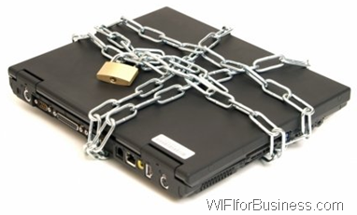
The requirements for Wi-Fi network security can be broken down into two primary components:
Authentication
  User Authentication
  Server Authentication
Privacy

Slide 33
User Authentication
  Username and password are Shared by Establishing a encrypted channel before sending username and password.
Server Authentication
  Digital Certificate is Used. Validation of digital certificate occurs automatically within client software.

Slide 34

The following are some of the Common Wi-Fi Securities.
  Service Set Identifier (SSID)
  Wired Equivalent Privacy (WEP)
  Wireless Protected Access (WPA)

Slide 35

SSID
  The SSID(Service Set Identifier) is a key that the wireless network administrator sets. Users must know the SSID to connect to an wireless network. However, network sniffing/scanning allows users to determine the SSID. Based on the automatic or manual configuration, the client can connect to the access point. An SSID is generally 32 bits long, but when displayed to the user, it is projected into a human readable ASCII format.

Slide 36
WEP
  WEP stands for Wired Equivalent Privacy, a standard for Wi-Fi wireless network security. WEP keys allow a group of devices on a local network (such as a home network) to exchange encoded messages with each other. A WEP key is a sequence of hexadecimal digits. These digits include the numbers 0-9 and the letters A-F.
  WEP keys are chosen by a network administrator. WEP keys are set on Wi-Fi routers, adapters and other wireless network devices. Matching WEP keys must be set on each device for them to communicate with each other.
WEP encryption uses the RC4 symmetric stream cipher.
Data
Encrypt
Encrypted Data
Encrypted Data
Decrypt
Data
Key
Key
http://www.fyneworks.com/encryption/rc4-encryption/

Slide 37
WPA
  Wi-Fi Protected Access (WPA) defined in response to serious weaknesses researchers had found in the previous system, WEP (Wired Equivalent Privacy).
  The WPA protocol uses the Temporal Key Integrity Protocol (TKIP). WEP used a 40-bit or 104-bit encryption key that must be manually entered on wireless access points and devices and does not change. TKIP employs a per-packet key, meaning that it dynamically generates a new 128-bit key for each packet and thus prevents the types of attacks that compromised WEP.

Slide 38

Eavesdropping
The data for application travels across networks in plaintext and is subject to network eavesdropping attacks, where an attacker uses network monitoring software to capture and potentially modify sensitive data.
Man-In-The-Middle Attacks
This attack forces AP-connected computers to drop their connections and reconnect with the cracker’s soft AP(disconnects the user from the modem so they have to connect again using their password which you can extract from the recording of the event). Man-in-the-middle attacks are enhanced by software such as LANjack and AirJack, etc.;
Denial Of Service
A Denial-of-Service attack (DoS) occurs when an attacker continually bombards a targeted AP (Access Point) or network with bogus requests, successful connection messages, failure messages, and/or other commands. These cause users to not be able to get on the network and may even cause the network to crash. These attacks rely on the abuse of protocols such as the Extensible Authentication Protocol (EAP).

Slide 39


Mobility
Cost
Security
Speed
Interference
High power consumption
Limited range

Slide 40


